Slide 1
DESIGN AND ANALYSIS OF ALGORITHMS
Bellman–Ford
Algorithm
Single-Source Shortest Path with Negative Edge Weights
A 5–7 minute classroom walkthrough
Notes:
Introduce Bellman–Ford as the shortest-path algorithm that remains dependable when some edge weights are negative.

Slide 2
THE CORE PROMISE
Bellman–Ford finds shortest paths even with negative edges
Computes shortest distances from one source to every reachable vertex in a weighted graph.
Supports negative edge weights.
Detects reachable negative-weight cycles.
u
+4
−2
S
v
Notes:
Start from one source vertex. Bellman–Ford propagates better distance estimates through the graph and explicitly checks whether a negative cycle prevents a finite answer.

Slide 3



WHY THIS ALGORITHM EXISTS
Negative edges make the shortest-path problem harder
Bellman–Ford
Handles negative edges and tests for reachable negative cycles.
Single-source shortest path asks for the minimum-cost route from source to every vertex.
Negative weights can make a later route cheaper than an earlier choice.
Dijkstra is not generally correct when negative edges are present; Bellman–Ford remains correct for graphs without reachable negative cycles.
Dijkstra
Fast choice for graphs whose edge weights are nonnegative.
Notes:
Emphasize the greedy assumption Dijkstra needs: once a vertex is finalized, no later route should improve it. A negative edge breaks that assumption.

Slide 4
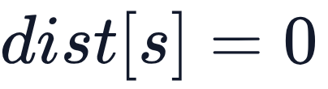
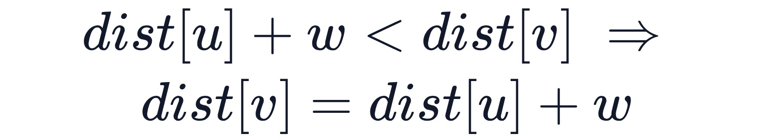

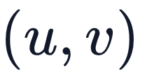

THE LOCAL MOVE
Relaxation improves a distance estimate
Initialize .
1
Initialize every other distance to .
2
For edge with weight , replace a worse estimate with a better one.
Relaxing an edge lowers the label when a cheaper route appears.
3
Notes:
Relaxation is the atomic operation. It does not choose a permanent answer; it keeps improving the current estimate whenever an edge reveals a cheaper route.

Slide 5
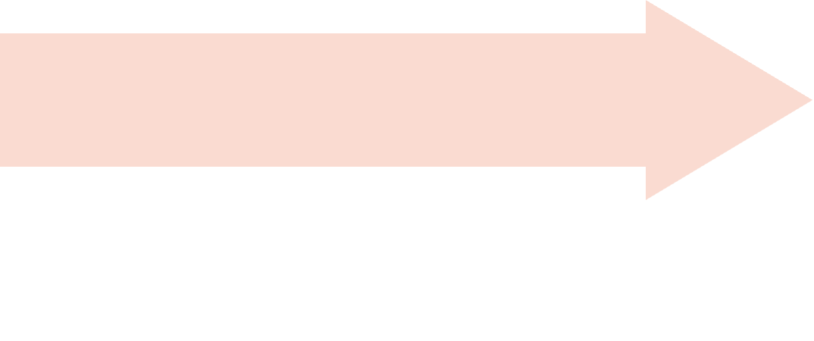
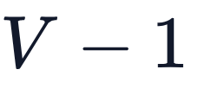
THE FULL PROCEDURE
Repeat relaxation, then test for a negative cycle
Check updates
Relax all edges
No update? Stop early.
Initialize
Repeat for iterations.
Source is 0; all others are ∞.
Return
Scan once more
Final distances or a warning.
An improvement means a reachable negative cycle.
Notes:
There can be at most V minus 1 edges in a simple shortest path. The extra scan is not another relaxation phase: it is a certificate that a reachable negative cycle still improves a distance.

Slide 6
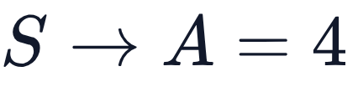
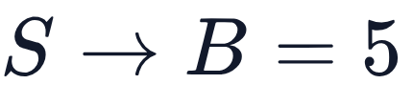
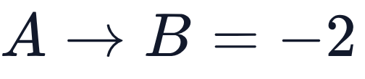
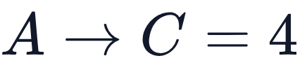
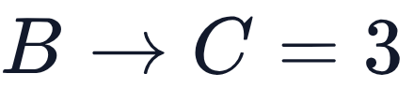











WORKED EXAMPLE
S reaches C most cheaply through B
Directed edges: , , , , .
A
−2
4
S
4
C
Start: , , , .
5
B
3
After relaxation: ; ; .
Orange: improving . Green: final shortest paths.
Final: , , , .
Shortest route to C: S→A→B→C; cost 4 + (−2) + 3 = 5.
Notes:
Trace the improving edge A to B. Its negative weight changes B from 5 to 2, which then makes the route from B to C cost 5. The shortest route to C is S→A→B→C.

Slide 7
Bellman–Ford pseudocode: three phases
BellmanFord(G, V, E, source):
# Initialize: for each vertex v, dist[v] = infinity; dist[source] = 0
# Relax: repeat V - 1 times; for each edge (u, v, w), if dist[u] != infinity and dist[u] + w < dist[v], set dist[v] = dist[u] + w
# Detect: for each edge (u, v, w), if dist[u] != infinity and dist[u] + w < dist[v], return "Negative-weight cycle exists"
return dist
Notes:
Point out the guard against infinity. An unreachable vertex must not participate in arithmetic. The final scan reuses the same relaxation condition, but interprets an improvement as evidence of a reachable negative cycle.

Slide 8

COMPLEXITY
Time is O(V × E); auxiliary space is O(V)
O(V × E)
O(V)
Auxiliary space for distance values and related per-vertex state, excluding graph storage.
Time complexity
Relaxation scans all edges up to times. One additional scan checks for a reachable negative-weight cycle.
O(E)
Additional graph storage with an edge-list representation.
Notes:
Separate working memory from the graph representation. Bellman–Ford stores per-vertex distance state in O(V), while an edge list contributes O(E) storage for the graph itself.

Slide 9








TRADE-OFFS
Bellman–Ford trades speed for flexibility
Advantages
Limitations and applications
Supports negative edge weights.
Usually slower than Dijkstra on nonnegative-weight graphs.
Detects reachable negative-weight cycles.
May perform many relaxations on large graphs.
Simple to implement.
A reachable negative cycle means finite shortest distances do not exist for vertices reachable from it.
Works for directed weighted graphs.
Used in network routing, arbitrage-detection concepts, graph optimization, and weighted-transition systems.
Notes:
Frame Bellman–Ford as a deliberate trade-off. It gives up speed to support a broader class of weighted directed graphs and to detect a condition that makes finite shortest paths impossible.

Slide 10
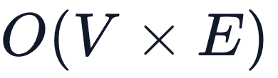
TAKEAWAY
Three ideas to remember
Finds single-source shortest paths.
1
Handles negative edge weights.
A
2
Detects reachable negative-weight cycles.
3
S
C
B
Runs in time.
4
Green paths show the final shortest route.
Thank You
Questions?
Notes:
Close by returning to the three-part mental model: initialize distances, repeatedly relax edges, then scan once more for a negative-cycle signal. Invite questions about the worked graph or pseudocode.

